Slide 1
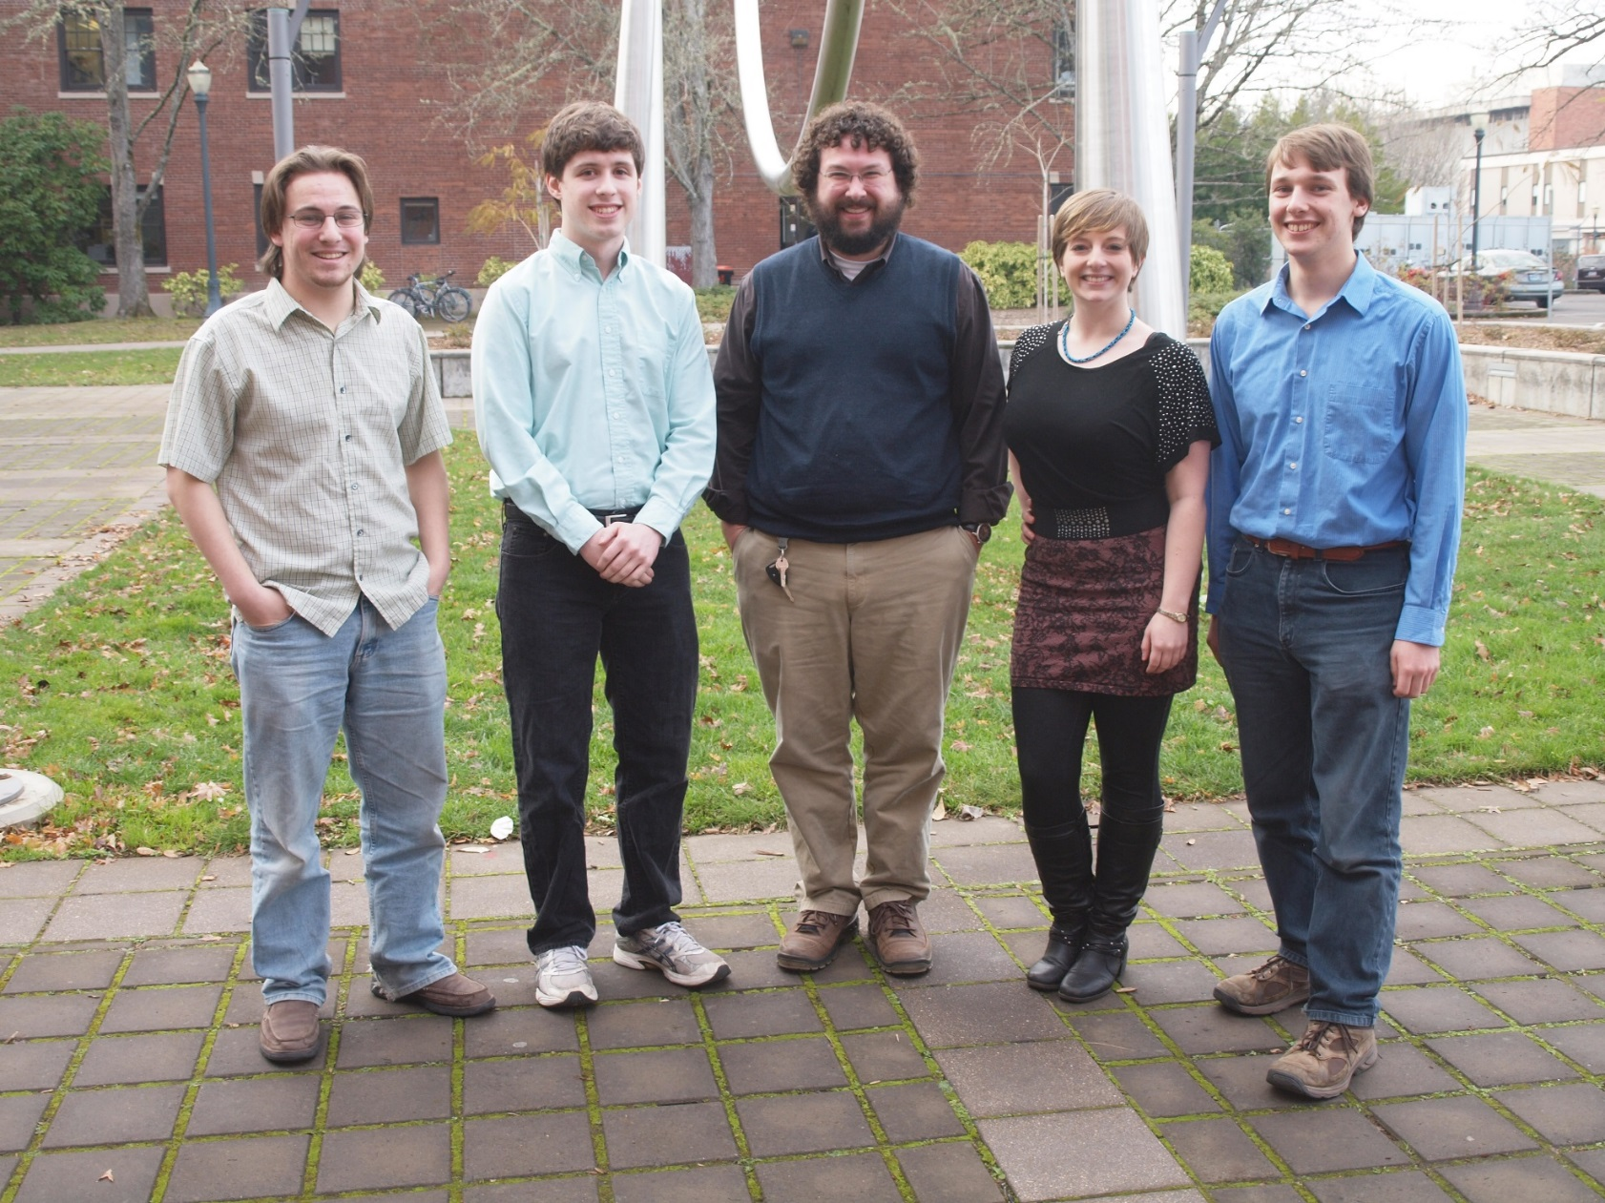


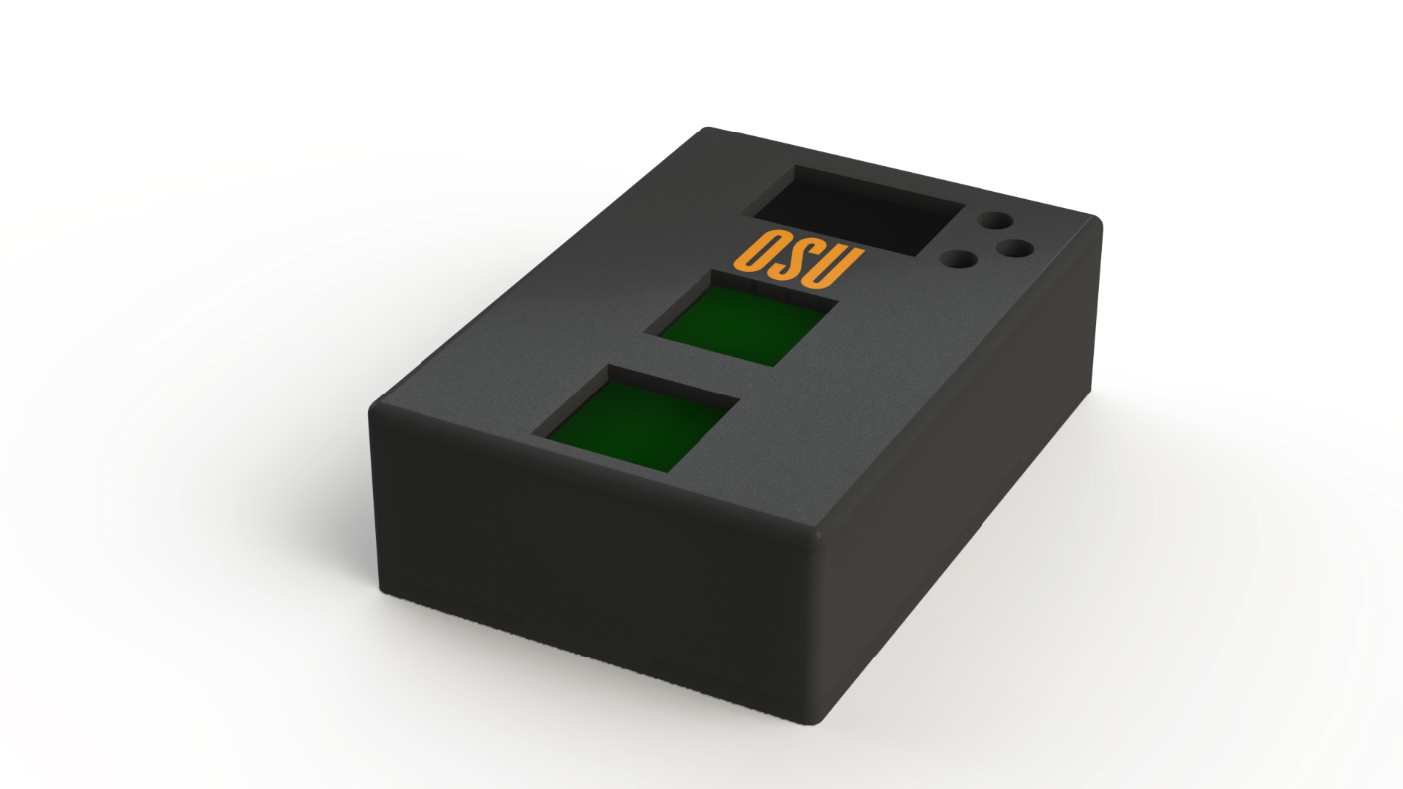
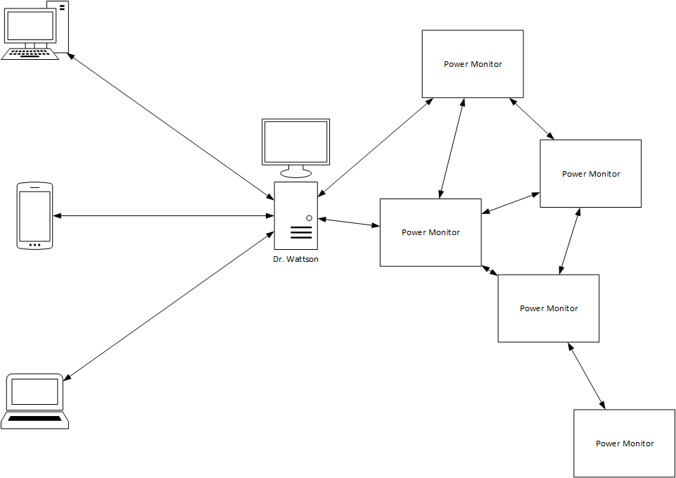

COLLEGE OF ENGINEERING
Electrical Engineering & Computer Science
Dr. Wattson Power Inspector
Berkeley Fisher, fisherb@engr.oregonstate.edu
Kit Morton, mortonki@engr.oregonstate.edu
Bennett Rand, randb@engr.oregonstate.edu
Emily Raterman, ratermae@engr.oregonstate.edu
Client: D. Kevin McGrath, dmcgrath@eecs.oregonstate.edu
EECS Capstone
Introduction and Background
Dr. Wattson: Power Analyzer is an integrated system which aims brings real time data collection and analysis of home energy usage to consumers in an easy and understandable way. Presently, average consumers do not have the tools to make informed decisions about their energy consumption. The goal of the Dr. Wattson project is to help consumers evaluate their current energy consumption habits and provide them with recommendations to help them improve their energy footprint. Installation of the Dr. Wattson distributed network of distributed power monitors will be a simple plug and play process, making it simple to use for consumers of all technical abilities. Dr. Wattson will collect and process the user’s energy use habits and present them with easy to understand graphs, comparisons, and suggestions to help them save energy and money. Additionally, the user will be able to upload and compare their energy data with others via social networking.
Project Description
The measurement unit will be an external device capable of being plugged into a wall outlet at any time by the user. Since the measurement unit is placed right before the appliance, it is able to accurately measure the device power consumption of the attached appliance. Once again, all of the remote units communicate with a centrally located data logging base station over a long distance.
This would require no technical knowledge to set up, since it simply plugs into an existing wall socket. This also makes it very easy to move to other outlets as the user desires. A sufficiently powerful power sensor could be used to acquire the waveform at high frequency, yielding very accurate results on all loads.
The data would be collected and transmitted to the centrally located base station for storage and analysis. The user would have access to the data through a web interface provided through the networking capabilities of the base station. It would be based around the Intel Atom architecture, a powerful platform allowing us to analyze large amounts of data This data would include information such as usage statistics, comparisons, and trends, with optional social networking integration.
Results
The Kill-A-Watt from P3 International costs $30. If one thousand Dr. Wattson remote measurement units were made, they would cost $47. On average, measurements show the Kill-A-Watt have an average 3.63% error including voltage, power, and current when compared to professional-grade measurement equipment. Specifications of the Kill-A-Watt claim 0.2% accuracy. With the same devices, Dr. Wattson has an average error of 0.59%. Both measure power at about one sample per second. Dr. Wattson could in theory, sample at a rate of 15 Hz from two separate devices, the Kill-A-Watt measures one.
The base station UI enables a user to compare power usage between devices faster and more accurately than multiple Kill-A-Watts. On average, users could compare power usage between two devices in X.XX seconds on Dr. Wattson and X.XX on the Kill-A-Watts. Users could also tell current power usage X.XX seconds faster on Dr. Wattson than on the Kill-A-Watt
Conclusions
The cost of Dr. Wattson is worth the benefits when compared to the competitors. Better power measurements with better and faster understanding of the data allows users to take control of their power usage. Users using our system were able to reduce their power usage by XXX kilowatt hours, saving about $XXX.
Dr. Wattson also has the capability to monitor many different types of power without much modification. 240 volt, 50 Hz, and DC systems just to start.
Importance
Between rising energy costs, depletion of natural resources, and the harmful effects of carbon emissions on our environment, there are many reasons to reduce energy consumption. Every year, the average American household uses 11,232 kilowatt hours of electricity, costing approximately $1,500. There are two potential ways of reducing a home’s power consumption: improving device efficiency and changing consumer’s behavior to reduce wasted energy. For many years, industry has been working to improve the efficiency of consumer electronics; however, consumers have been slower to catch on. To make effective steps toward reducing power consumption, there are two challenges to overcome: People must first know how much power their devices use, and second, what they can do to most significantly reduce power used in particular applications. Our project will attempt to address both of these problems.

